Slide 1

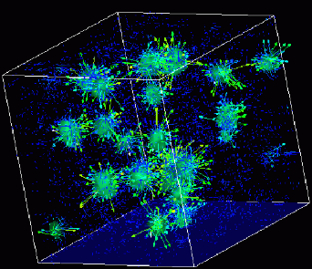
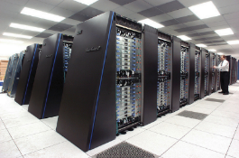
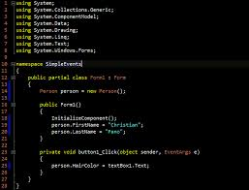
Advanced
Scientific Computing
(SciComp 201)
Session 10
Equilibrium Simulation, Functional Equations

Slide 2
Session Goals
More practice with the for() and while() loop constructs
Understand the C++ class idiom
Review “is-a” and “has-a” class relationships
Create a collection of objects using the vector<> template
Develop functional equations
Calculate center of mass of a Jenga pile
Model the construction of a cantilever

Slide 3
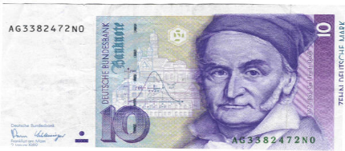
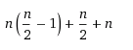
A Shortcut
Carl Friedrich Gauss
(1777 – 1855)
Sum the numbers from 1 to 10
1
2
3
4
5
6
7
8
9
10
1 | 9
2 | 8
3 | 7
4 | 6
5
10
4 matched rows that each sum to 10
1 row that is = 10 / 2 = 5
1 row that is = n = 10
= 55

Slide 4
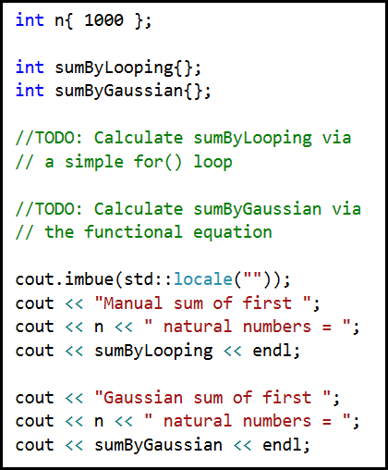
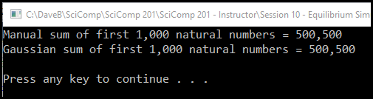
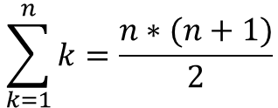
Lab 1 – Gaussian Summation
Write a C++ console application to display the sum of the first 1,000 natural numbers using two different methods:
A simple for() loop
The functional equation for Gaussian summation:
$$\sum_{k=1}^{n}{k=\frac{n∗(n+1)}{2}}$$

Slide 5
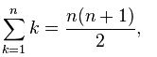
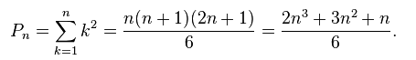
Another Shortcut
Sum of first n
natural numbers:
Sum of squares of first n natural numbers:
n | n^2 | Sum
1 | 1 | 1
2 | 4 | 5
3 | 9 | 14
4 | 16 | 30
5 | 25 | 55
6 | 36 | 91
7 | 49 | 140
8 | 64 | 204
9 | 81 | 285
10 | 100 | 385

Slide 6
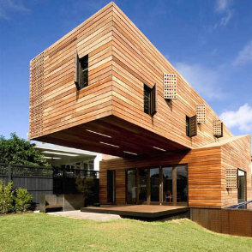
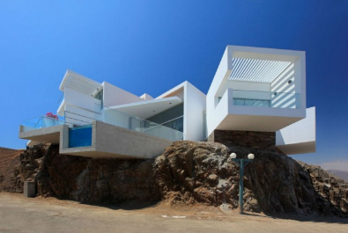
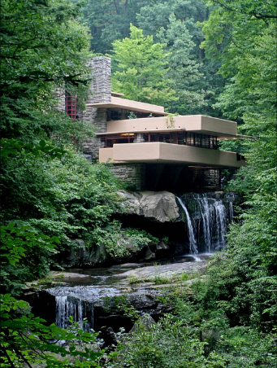
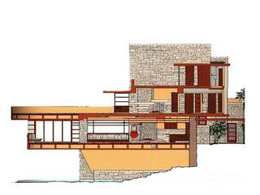
Cantilever Building Design

Slide 7
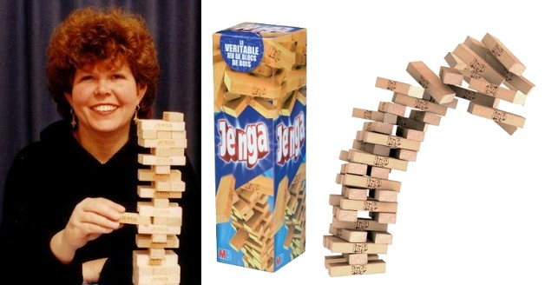
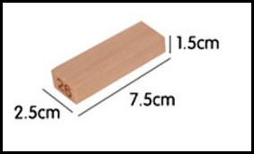
Jenga Block Dimensions
Leslie Scott created Jenga in 1983

Slide 8
Jenga Block Dimensions
y+
y+
(7.5, 1.5)
(1.5, 7.5)
3
15
x+
15
(0,0)
x+
Center of Mass = Average of All Corner Coordinates
(in both x & y dimensions)
(0,0)
3

Slide 9
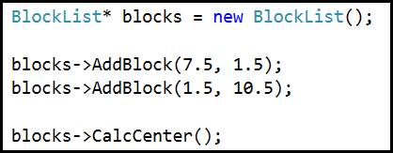
1st Ensemble
y+
Center of Mass = Average of All Corner Coordinates
(in both x & y dimensions)
15
(4.5, 6.0)
3
x+
15
(0,0)

Slide 10
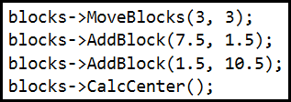
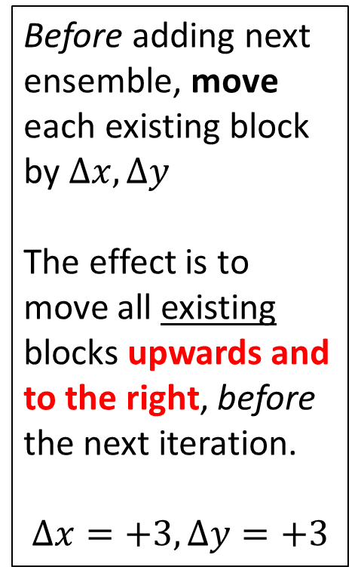
2nd Ensemble
Before adding next ensemble, move each existing block by $Δx, Δy$
The effect is to move all existing blocks upwards and to the right, before the next iteration.
$$Δx=+3, Δy=+3$$
15
(6.0, 7.5)
3
15
3

Slide 11
How many 2-block ensembles can be balanced on a vertical base?
15
Try this now with your blocks

Slide 12
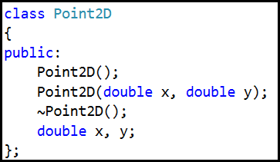
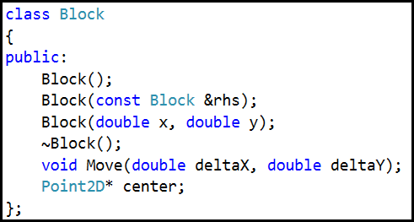
C++ Class Hierarchy
A block “has-a” center (of mass)
A center “is-a” Point2D

Slide 13
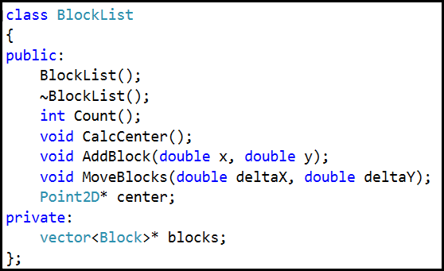
C++ Class Hierarchy
BlockList “has-a” vector of Blocks
BlockList “has-a” center (of mass)

Slide 14
Header and Source File Dependency
stdafx.h
MSFT Precompiled Feature
std:: Libraries (<vector>)
CERT ROOT declarations
#pragma once
Blocks.h
Custom class interfaces
Point2D, Block, BlockList
using namespace std
#pragma once
Blocks.cpp
Implements custom classes
Point2D, Block, BlockList
using namespace std
JengaCantilever.cpp
main()
Creates a BlockList()
using namespace std
Waits for keypress
JengaCantilever.EXE
Windows Console App
Run by Visual Studio debugger

Slide 15
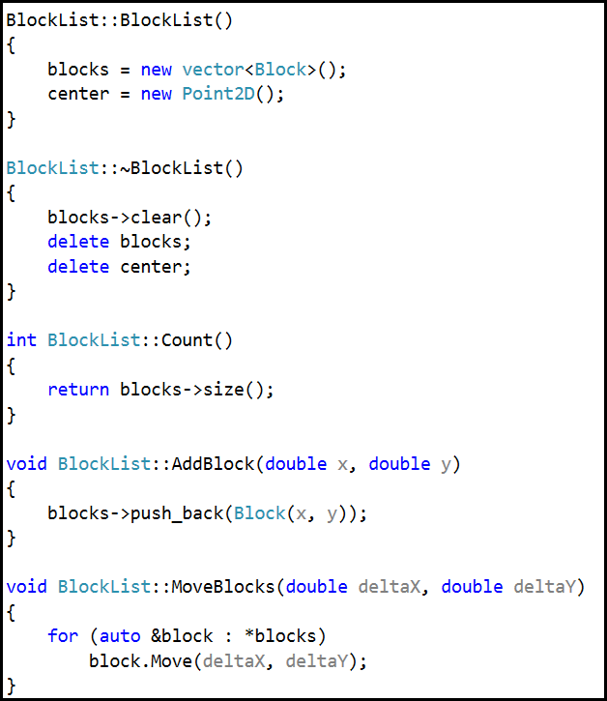
C++ Idioms
Scope Resolution ::
Default Constructor
Operator new
~ Destructor
Operator delete
vector clear()
vector size()
vector push_back()
range-based for()
auto
& references
* pointers

Slide 16
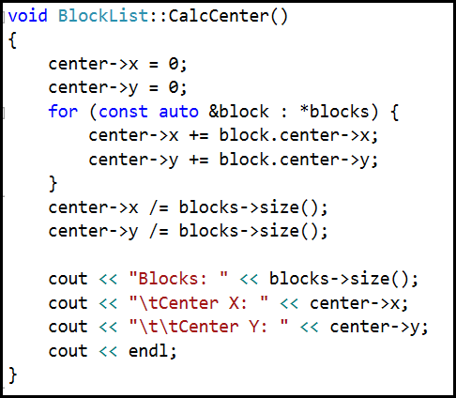
The Center of Mass is a Mean

Slide 17
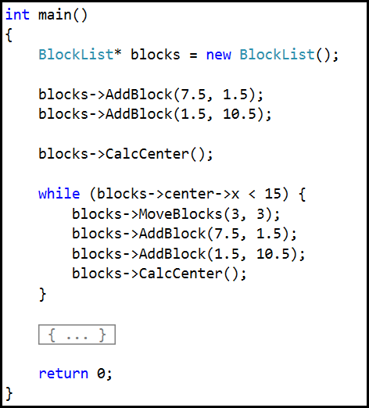
A while() Loop
15

Slide 18
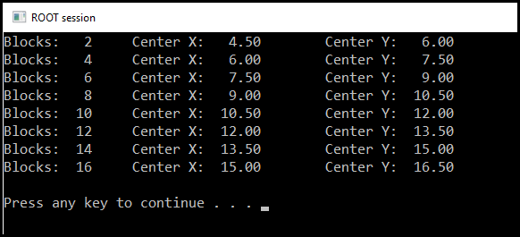
14 Block Jenga Cantilever

Slide 19
14 Block Jenga Cantilever
y+
(13.5, 15.0)
The center-of-mass in the x dimension must be less than 15.0 which is the rightmost edge of the vertical base block, otherwise the bottommost horizontal block would be unsupported
x+
(0,0)

Slide 20
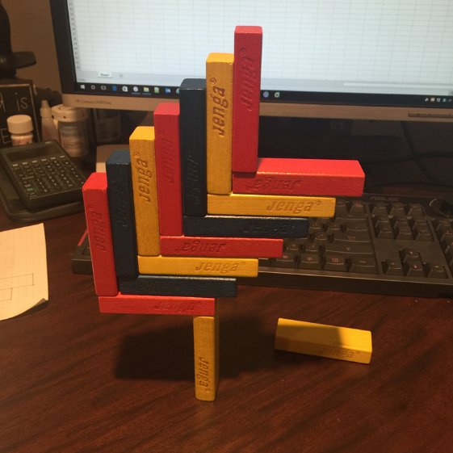
14 Block Jenga Cantilever
Can we simulate the construction of a 15 block Jenga cantilever?

Slide 21
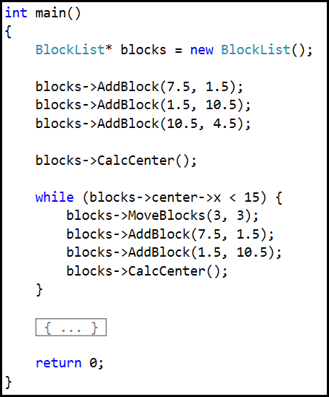
Lab 2 15 Block Jenga Cantilever
Add this line of code

Slide 22
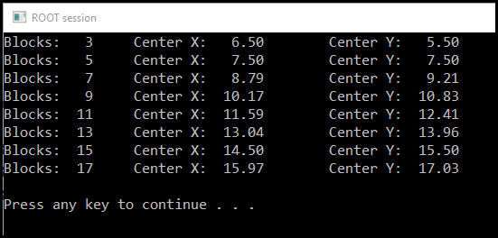
15 Block Jenga Cantilever

Slide 23
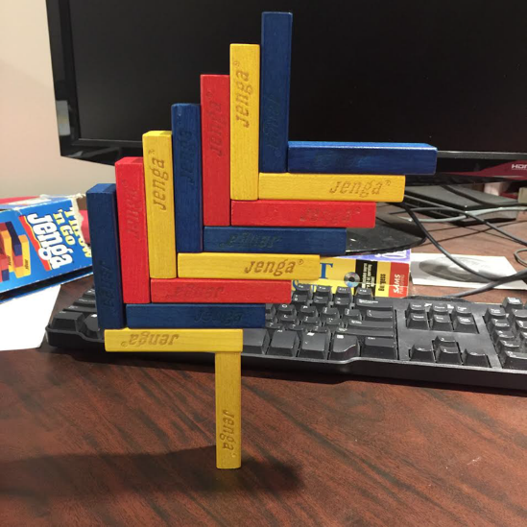
15 Block Jenga Cantilever
Try this now with your blocks

Slide 24
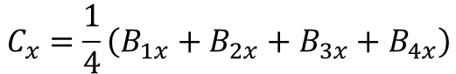
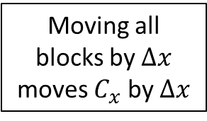
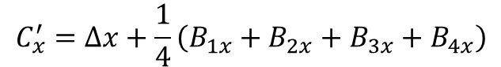
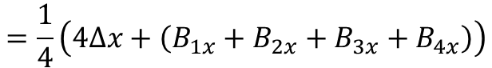
Functional Equation
$${Pile Center of Mass}_{X}=\frac{\sum_{n=1}^{blocks}{\sum_{k=1}^{4}{\left({{{Coordinate}_{x} of Corner}_{k} of Block}_{n}\right)}}}{4∗Number of Blocks}$$
$$C_{x}=\frac{1}{4}\left(B_{1x}+B_{2x}+B_{3x}+B_{4x}\right)$$
$$=\frac{1}{4}\left(\left(B_{1x}+∆x\right)+\left(B_{2x}+∆x\right)+\left(B_{3x}+∆x\right)+\left(B_{4x}+∆x\right)\right)$$
Moving all blocks by $∆x$ moves $C_{x}$ by $∆x$
$$=\frac{1}{4}\left(4∆x+\left(B_{1x}+B_{2x}+B_{3x}+B_{4x}\right)\right)$$
$$C_{x}^{′}=∆x+\frac{1}{4}\left(B_{1x}+B_{2x}+B_{3x}+B_{4x}\right)$$

Slide 25
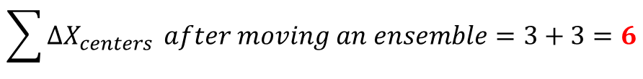
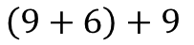

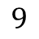
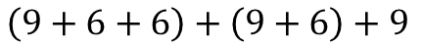
Functional Equation – 14 Block Cantilever
$$\sum{X_{centers}}of a 2 block ensemble=7.5+1.5=9$$
$$\sum{∆X_{centers}} after moving an ensemble=3+3=6$$
2 Blocks
$$9$$
4 Blocks
$$\left(9+6\right)+9$$
6 Blocks
$$\left(9+6+6\right)+\left(9+6\right)+9$$
8 Blocks
$$\left(9+6+6+6\right)+\left(9+6+6\right)+\left(9+6\right)+9$$
10 Blocks
$$\left(9+6+6+6+6\right)+\left(9+6+6+6\right)+\left(9+6+6\right)+\left(9+6\right)+9$$

Slide 26
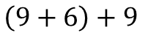
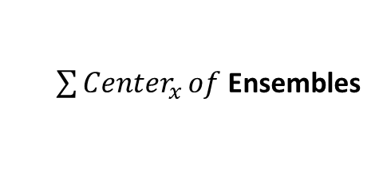
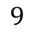
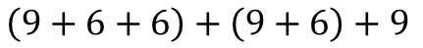
Functional Equation – 14 Block Cantilever
# of 9’s
# of 6’s
$\sum{{Center}_{x}}of$Ensembles
1
0
$$9$$
2
1
$$\left(9+6\right)+9$$
3
3
$$\left(9+6+6\right)+\left(9+6\right)+9$$
4
6
$$\left(9+6+6+6\right)+\left(9+6+6\right)+\left(9+6\right)+9$$
5
10
$$\left(9+6+6+6+6\right)+\left(9+6+6+6\right)+\left(9+6+6\right)+\left(9+6\right)+9$$

Slide 27
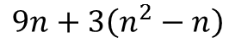
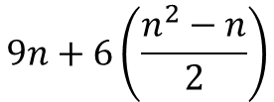
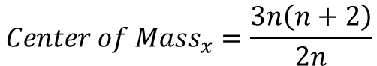
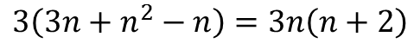
Functional Equation – 14 Block Cantilever
# of 9’s
# of 6’s
n
$$9n+6\left(\frac{n^{2}−n}{2}\right)$$
1
0
1st Ensemble
2
1
2nd Ensemble
$$9n+3\left(n^{2}−n\right)$$
3
3
3rd Ensemble
$$3\left(3n+n^{2}−n\right)=3n\left(n+2\right)$$
4
6
4th Ensemble
$${Center of Mass}_{x}=\frac{3n\left(n+2\right)}{2n}$$
5
10
5th Ensemble
There are two blocks per ensemble

Slide 28
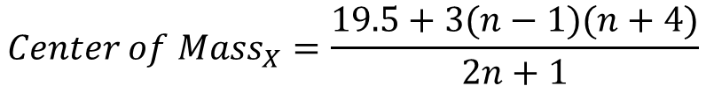
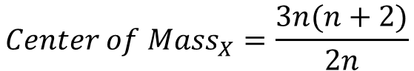
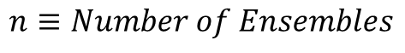
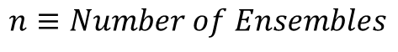
Functional Equations
Jenga 14 Block Cantilever
$${Center of Mass}_{X}=\frac{3n(n+2)}{2n}$$
$$n≡Number of Ensembles$$
Jenga 15 Block Cantilever
$${Center of Mass}_{X}=\frac{19.5+3(n−1)(n+4)}{2n+1}$$
$$n≡Number of Ensembles$$

Slide 29


Functional Equations
Jenga 14 Block Cantilever
Jenga 15 Block Cantilever
Because the center-of-mass in the X & Y dimensions are closer in a 15 block cantilever, it seems to tip over more easily than a 14 block cantilever

Slide 30


Cantilever Building Design

Slide 31

13 Block Jenga Cantilever (with missing middle)

Slide 32



Slide 33



Slide 34
Now you know…
Looping with for() and while() statements
Using a class to group data elements and functions
Identity = “is-a” while ownership (contains) = “has-a”
A vector<> template is a flexible container of similar types
SciComp often involves simulating the real world before spending $$$
Developing a functional equation can often produce the answer faster than looping to calculate it
A complex construction of objects balances on its virtual center of mass
Cantilever designs can reduce load on external walls to increase building survivability

